Slide 1

DevOps
Puppet
Configuration Management Tool

Slide 2
Team Members
Aswin Barath
Suprakash Mandal
Vyshnav Raj
Srijan Kumar
Venkatachalapathi
Varun S

Slide 3

Puppet
What is Puppet?
What you need to know
Key features of puppet
Why use Puppet?
Working of Puppet

Slide 4
What is Puppet?
Puppet is a pull-based configuration tool
It ensures that all systems are configured the way we want.
Puppet is also used as a deployment tool for automatic software deploys.

Slide 5
What is Puppet?
Puppet implements infrastructure as code.
Includes its own declarative language.
Declarative = define WHAT end result you want and puppet will figure out how to execute it.

Slide 6
Key features of Puppet
Big Open Source Community.
Large user base
Platform support
Documentation
Requires limited programming knowledge

Slide 7


Why use Puppet?
Scenario: Multiple servers are going down at the same time
For companies, each second a website or an app is down, it will result in a loss of money.

Slide 8


Why use Puppet?
With puppet, we can write a simple script in ruby and deploy it to servers.
Either we can rollback or set a new state for the servers.

Slide 9
Working of Puppet
The Puppet master is the system that manages important configuration information for all of the nodes that it controls by using manifests.

Slide 10
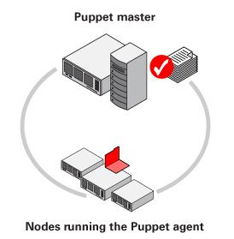
Working of Puppet

Slide 11
Working of Puppet
1.Node that is running the Puppet agent collects data about itself using facts
2.Agent sends facts to puppet master
3. Master Compiles a catalog based on data for how the node should be configured
4.Master sends catalgog back to agent
5.Agent configures itself and reports back to master

Slide 12
Thank You!

